Slide 1
Face Mask Detection
22F-3770
22F-3041

Slide 2
Introduction
The Real-time Face Mask Detection System is a direct response to the ongoing COVID-19 pandemic & smog, aiming to automate the process of detecting whether individuals are wearing face masks.
This system uses the power of deep learning and computer vision technologies to achieve accurate and efficient mask detection in real-time scenarios.
To enforce mask-wearing policies effectively, there is a growing need for automated systems capable of detecting whether individuals in public spaces are wearing masks correctly.
In response to this need, our project introduces a real-time face mask detection system utilizing deep learning techniques.

Slide 3
Objective
The primary objective of this project is to develop a robust and accurate system capable of identifying faces in real-time video streams and determining whether individuals are wearing masks or not.
By leveraging state-of-the-art deep learning architectures and computer vision algorithms, our aim is to create a versatile solution that can be deployed in various settings, including hospitals, airports, public transport, and retail establishments, to promote adherence to mask-wearing guidelines and mitigate the spread of infectious diseases.

Slide 4
Problem Statement
The spread of respiratory illnesses, increase by factors such as air pollution and outbreaks of infectious diseases like swine flu, underscores the critical importance of mask-wearing as a preventive measure to safeguard public health.
However, ensuring that everyone wear masks incase of outbreak of any epidemic.
To address these challenges, there is a pressing need for automated systems that can reliably detect and classify individuals based on their mask-wearing behavior in real-time.

Slide 5
Methodology
Data Collection:
I have downloaded the dataset from Kaggle.
The dataset is divided into two categories.
With Mask
Without Mask
I have 3,792 images of individuals with masks.
I have 3,828 images of individuals without masks.

Slide 6
Methodology
Data Preprocessing:
Resize images to a standard size suitable for the chosen neural network architecture (e.g., 224x224 pixels for MobileNetV2).
Normalize pixel values to a range suitable for the chosen model (e.g., [-1, 1] or [0, 1]).
Perform data augmentation to increase the diversity of the training set (e.g., rotation, zoom, horizontal flip).

Slide 7
Methodology
Model Selection and Training:
Choose a suitable deep learning model architecture for the task such as MobileNetV2.
Fine-tune the selected pre-trained model on the face mask dataset.
Split the dataset into training and testing sets.
Train the model using the training set, validating the performance on the testing set.
Optimize hyperparameters such as learning rate, batch size, and number of epochs to achieve the best performance.

Slide 8
Model Evaluation:
The performance of model has been evaluated by precision, recall, f1-score, and support.
The performance metrics provided indicate that the face mask detection model achieved high accuracy and precision across both classes (with mask and without mask), as well as a balanced recall and F1-score.
Accuracy:
The overall accuracy of the model is 99%, indicating that it correctly classified 99% of the face images into their respective classes (with mask or without mask).

Slide 9
Model Evaluation:
Precision:
Precision measures the proportion of correctly predicted positive instances (true positives) out of all instances predicted as positive (true positives and false positives).
For the "with mask" class, the precision is 98%, indicating that 98% of the instances predicted as "with mask" were actually wearing masks.
For the "without mask" class, the precision is 100%, meaning that all instances predicted as "without mask" were indeed not wearing masks.
These high precision scores demonstrate the model's ability to minimize false positives and avoid misclassifying instances.

Slide 10
Model Evaluation:
Recall:
Recall, also known as sensitivity, measures the proportion of correctly predicted positive instances (true positives) out of all actual positive instances (true positives and false negatives).
For both classes, "with mask" and "without mask," the recall scores are around 98-100%. This indicates that the model effectively captured the majority of positive instances in each class, minimizing false negatives.

Slide 11
Model Evaluation:
F1-Score:
The F1-score is the harmonic mean of precision and recall, providing a balance between the two metrics. It ranges from 0 to 1, with higher values indicating better model performance.
The F1-score for both classes is around 99%, indicating a high level of performance in terms of both precision and recall.
The model's performance metrics, including high accuracy, precision, recall, and F1-score, demonstrate its effectiveness in accurately classifying face images into "with mask" and "without mask" categories.

Slide 12
Methodology
Model Selection for Face Detection:
The Caffe model was likely chosen for face detection.
Caffe models trained on large datasets of annotated images, such as faces, tend to achieve high accuracy in detecting objects of interest.
This accuracy is crucial for tasks like face detection, where the correct identification of objects is essential.

Slide 13
Methodology
Model Selection for Face Detection:
The deploy.prototxt file was used along with pretrained caffe model.
It is a configuration file used for model deployment in the Caffe deep learning framework.
The Caffe model (res10_300x300_ssd_iter_140000.caffemodel) and its corresponding deploy prototxt file (deploy.prototxt) are being used for face detection

Slide 14
Face Mask Detection Using Images
This part of the code performs face detection and face mask prediction on an input image using a pre-trained Caffe model for face detection (res10_300x300_ssd_iter_140000.caffemodel) and a MobileNetV2 model for face mask classification (mobilenet_v2.model).
prototxtPath and weightsPath specify the paths to the deploy prototxt file and pre-trained Caffe model for face detection, respectively.
cv2.dnn.readNet loads the Caffe model and deploy prototxt into memory using OpenCV's Deep Neural Network (dnn) module.
model=load_model loads the MobileNetV2 model for face mask classification from the specified path.

Slide 15
Face Mask Detection Using Images
image=cv2.imread reads the input image from the specified path.
The shape of the input image (h, w) is obtained to later calculate the bounding box coordinates.
cv2.dnn.blobFromImage preprocesses the input image by resizing it to (300, 300) pixels, applying mean subtraction, and scaling the pixel values.
net.setInput(blob) sets the input blob (preprocessed image) to the Caffe model for face detection.
net.forward() performs forward pass inference to obtain the face detections.

Slide 16
Face Mask Detection Using Images
The code loops over each detection to extract the confidence score and bounding box coordinates.
If the confidence score exceeds a threshold of 0.5, the bounding box coordinates are used to extract the face region.
The face region is resized to (224, 224) pixels and preprocessed using MobileNetV2's preprocess_input function.
The preprocessed face image is passed through the MobileNetV2 model for face mask prediction.
Based on the predicted mask probabilities, a label ("Mask" or "No Mask") and corresponding color are determined.
The label and bounding box are drawn on the original image using OpenCV's drawing functions (cv2.putText and cv2.rectangle).

Slide 17
Displaying Output
The annotated output image with face detections and mask predictions is displayed using cv2.imshow.
The program waits for a key press (in this case, 0 indicates any key) using cv2.waitKey.
Finally, the OpenCV windows are destroyed using cv2.destroyAllWindows after the user presses any key.

Slide 18
Face Mask Detection Using Video Streaming:
This function is responsible for detecting faces in a given frame and predicting whether each detected face is wearing a mask or not.
It takes three parameters: frame (the input frame to analyze), faceNet (the pre-trained face detection model), and maskNet (the pre-trained MobileNetV2 model for face mask classification).
The pre-trained face detection model and MobileNetV2 model for face mask classification are loaded using their respective prototxt/weights files and model paths
Inside the function:
The dimensions of the input frame (frame) are obtained, and a blob is constructed from the frame using cv2.dnn.blobFromImage.
The pre-trained face detection model (faceNet) is used to perform forward pass inference on the blob, yielding face detections.

Slide 19
Face Mask Detection Using Video Streaming:
For each detected face:
Bounding box coordinates are extracted from the detections.
The face region is extracted from the frame, preprocessed, and added to a list of faces (faces) along with its corresponding location (locs).
If faces are detected, the pre-trained MobileNetV2 model (maskNet) is used to predict whether each face is wearing a mask or not.
The function returns a tuple containing lists of face locations (locs) and mask predictions (preds).

Slide 20
Face Mask Detection Using Video Streaming:
Video Stream Processing:
The code initializes a video stream using VideoStream and starts reading frames from the camera source (e.g., webcam).
Inside the while loop:
Frames are continuously read from the video stream and resized to a maximum width of 400 pixels using imutils.resize.
The detect_and_predict_mask function is called to detect faces and predict masks for each frame.
For each detected face, the predicted mask label and bounding box are drawn on the frame using OpenCV drawing functions (cv2.putText and cv2.rectangle).
The annotated frame is displayed using cv2.imshow.
The loop continues until the user presses the 'q' key, upon which the loop breaks, and the video stream is stopped.

Slide 21
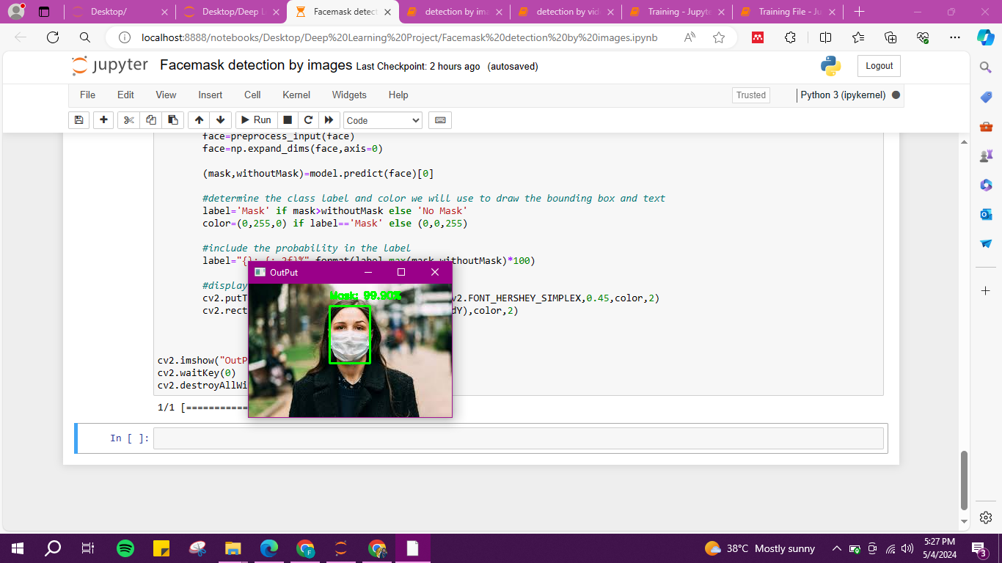
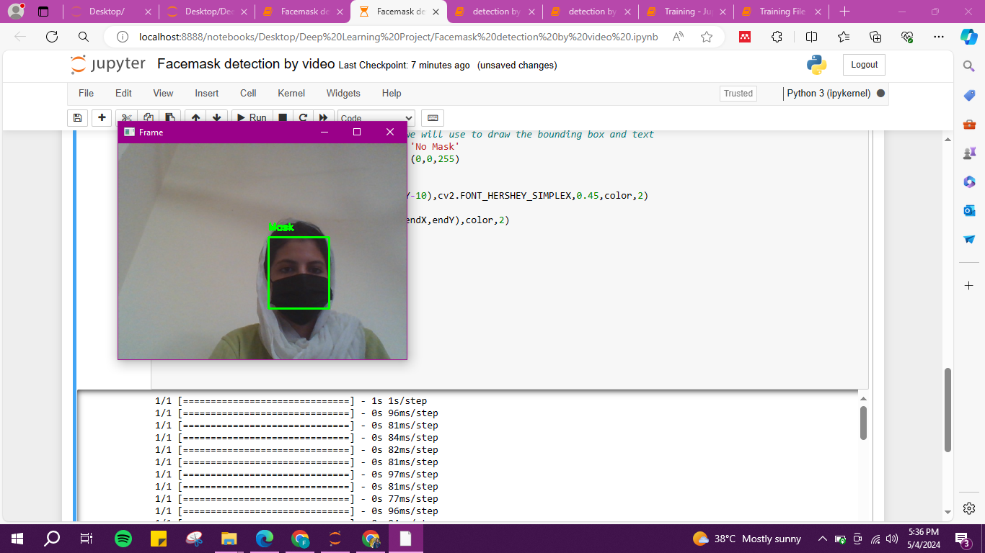
Results
Our Model is Correctly identifying if an individual is wearing mask or not on images and also on video streaming.

Slide 22
Conclusion
In conclusion, the implemented face mask detection system demonstrates the capability to automatically identify individuals wearing masks in real-time video streams.
By leveraging pre-trained models for face detection and mask classification, the system effectively annotates each frame with mask labels and bounding boxes, aiding in the enforcement of mask-wearing guidelines in various settings.
While the current implementation achieves promising results, there is ample room for future enhancements, including accuracy improvements, optimization for real-time performance, and expansion of functionality to address evolving needs.
Overall, the system presents a valuable tool for promoting public health and safety in the context of contagious disease mitigation.

Slide 23
Future Work
Real-time Performance Optimization: Optimize the code and model architectures for faster inference speed, enabling real-time deployment on resource-constrained devices.
Dataset Expansion: Collect and annotate larger datasets with diverse images of individuals wearing masks in various settings to improve model generalization.
Multi-Class Classification: Extend the model to classify different types of masks (e.g., N95, surgical, cloth) or detect other facial accessories (e.g., glasses, hats).
Deployment: Integrate the face mask detection system into existing surveillance systems or public health applications for automated monitoring and enforcement of mask-wearing policies.

